Slide 1
LINK STATE ROUTING
In link state routing, if each node in the domain has the entire topology of the domain, the node can use Dijkstra’s algorithm to build a routing table.
The topics discussed in this section include:
Building Routing Tables

Slide 2
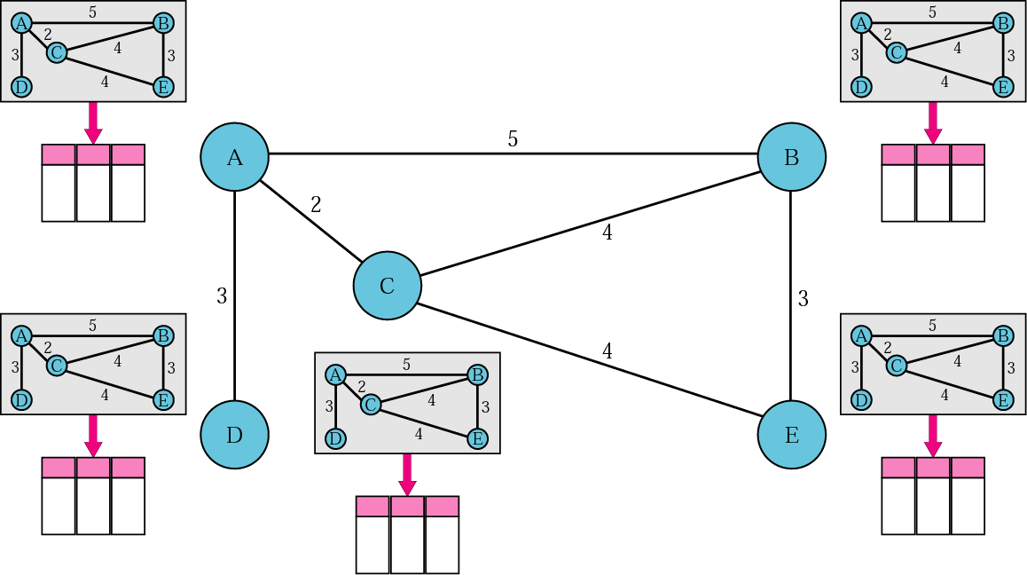
Concept of link state routing

Slide 3
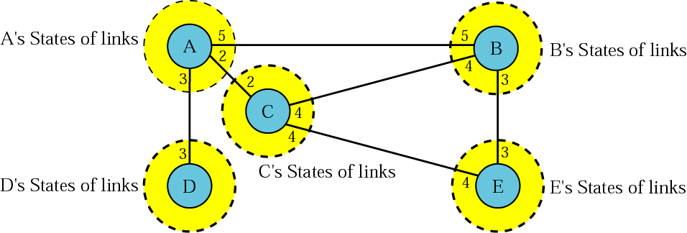
Link state knowledge

Slide 4
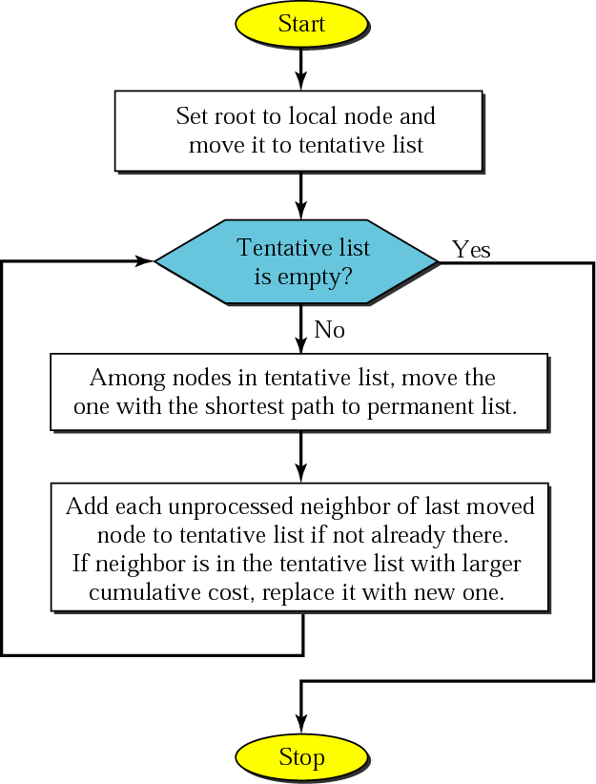
Dijkstra algorithm

Slide 5
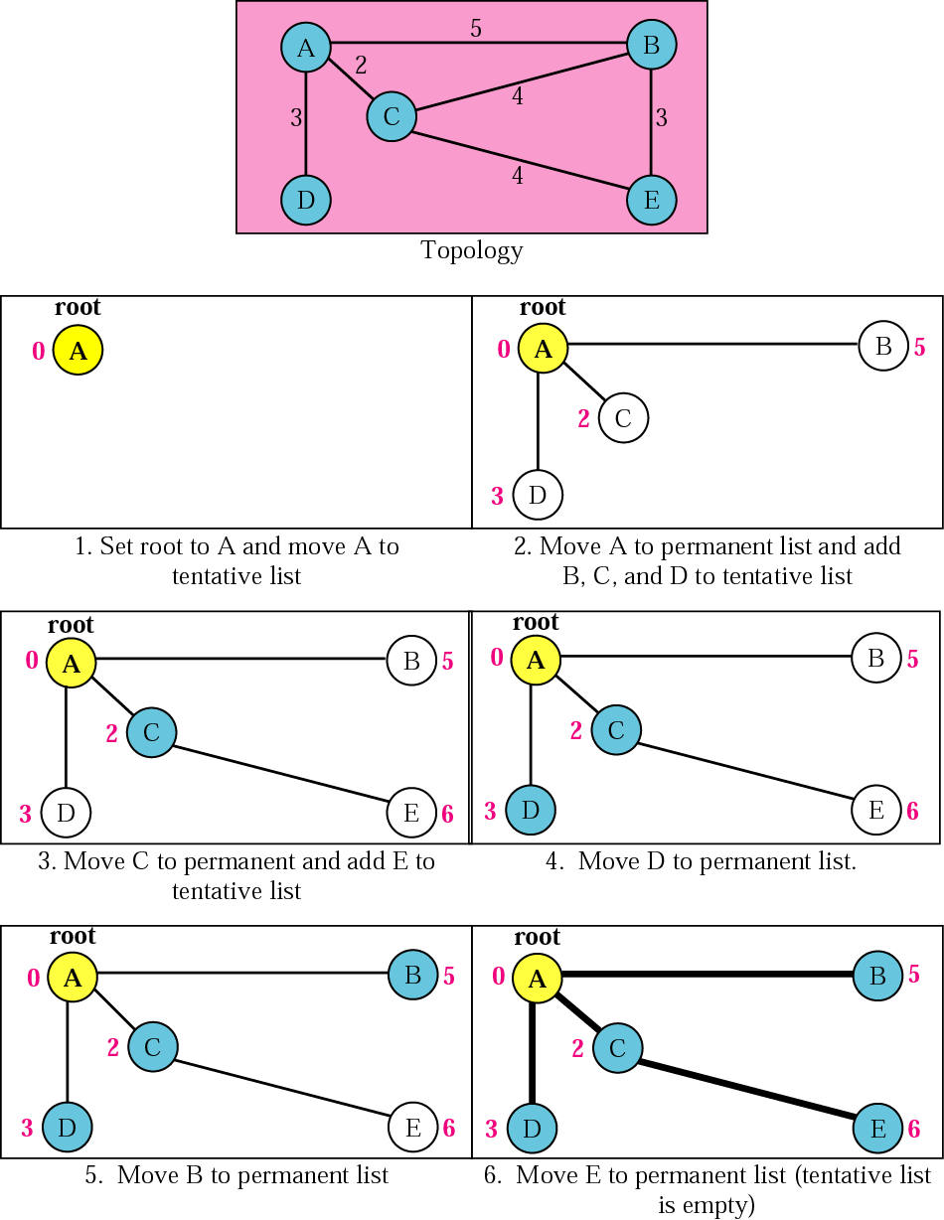
Example of formation of shortest path tree

Slide 6
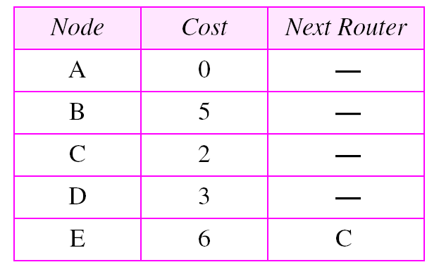
Routing table for node A

